Slide 1
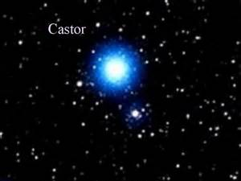
Castor
This is the 23rd brightest star in the sky.
Other Names:
Alpha Gem
Alpha Geminorum

Slide 2
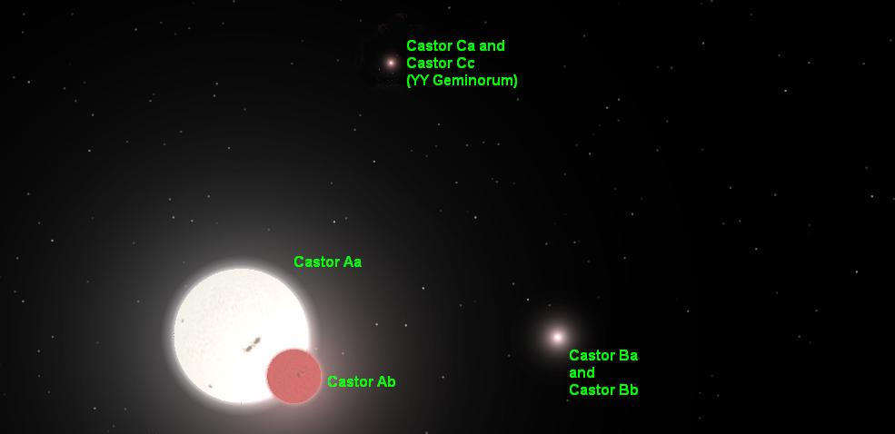
For visual astronomers, Castor is known as a double star in Gemini. Further spectroscopy has revealed that there are actually 6 stars in the system.

Slide 3

Castor

Slide 4

Castor
51 light
years away
The light we’re seeing left in the late 1960s…about the time the Gemini space program was wrapping up their missions.

Slide 5
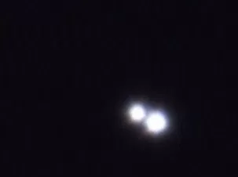
Castor
Both stars are about the same size, but a medium sized telescope is necessary to split them.

Slide 6
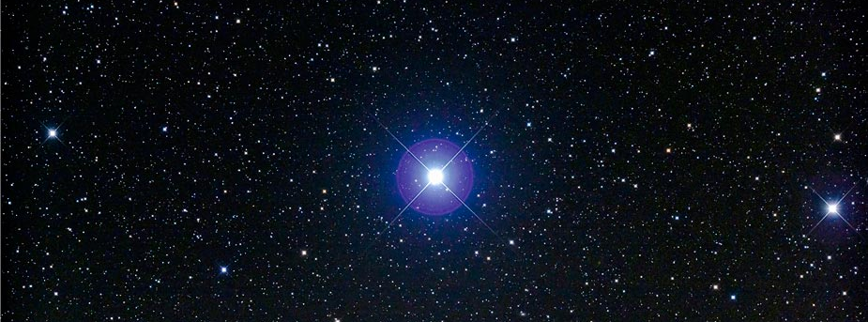
Castor
They have an orbital period of 467 years.
They are separated by 107 astronomical units (about the distance from the Sun to Pluto).

Slide 7
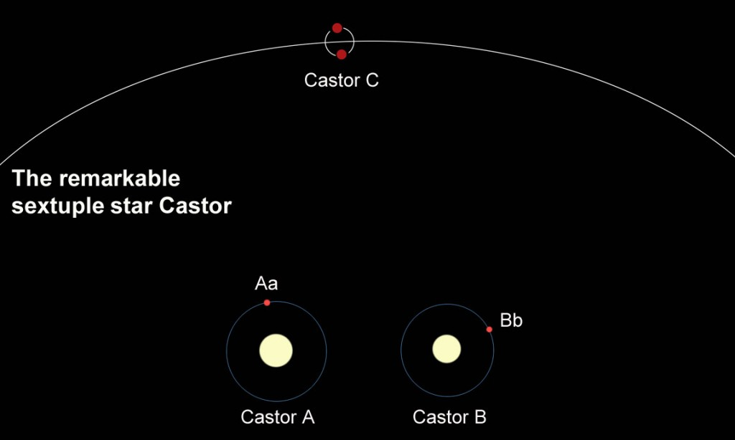

Slide 8

Castor
Castor is part of Gemini (the Twins).
In Greek mythology Castor & Pollux are really half-brothers and their mother is Leda. Pollux’s father is Zeus and he is immortal. Castor’s father is King Tyndareus, King of Sparta. Their sister was Helen of Troy.

Slide 9
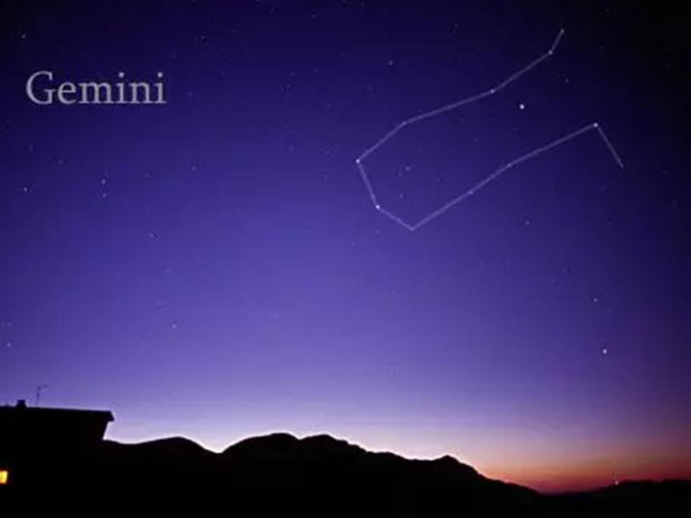
Castor
Pollux

Slide 10
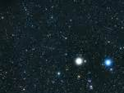
Gemini: Castor & Pollux
They are not related gravitationally.
Pollux is 34 light years away & an orange giant star.
Castor is 51 light years away and a double white star.

Slide 11
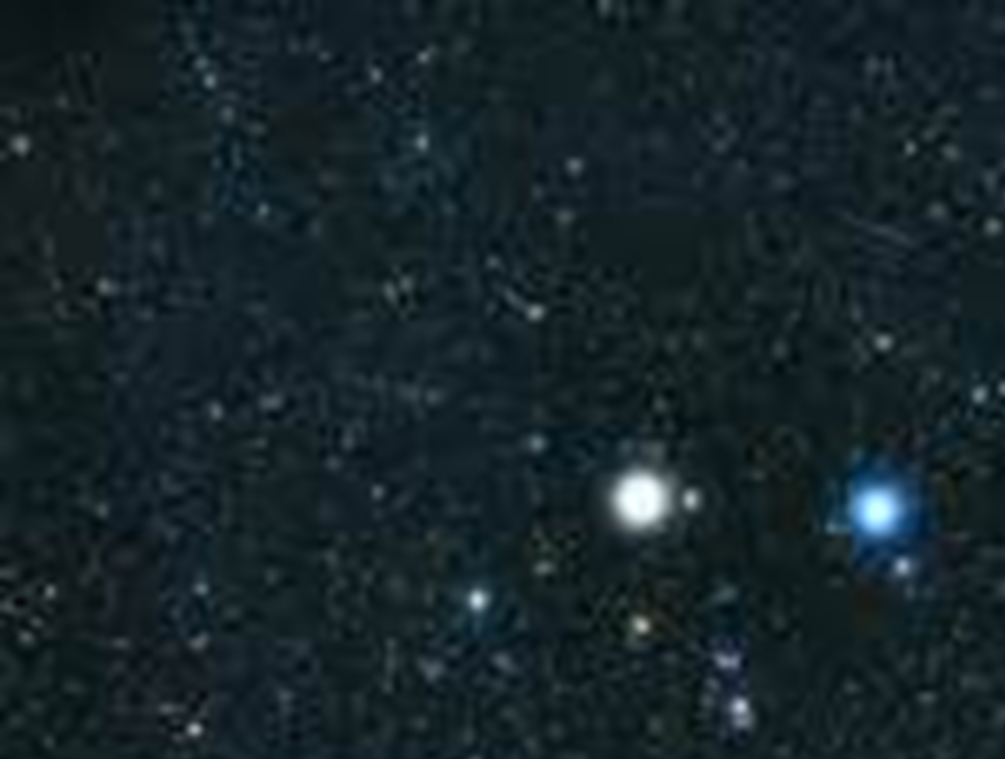
Gemini: Castor & Pollux
Castor is known as Alpha Gem, but Pollux (Beta Gem) is actually brighter. It is likely that one of them has changed in luminosity over the years.

Slide 12
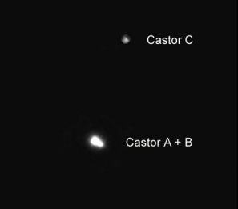
Castor
Castor A and Castor B
are both about 370 million years old. Castor C looks to be only 30-85 million
years old and
we’re not sure
how it got connected to the other two.

Slide 13
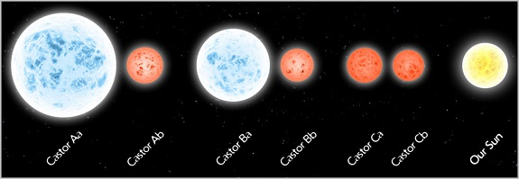
The Castor star system size comparisons.

Slide 14
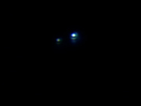
Castor A: double star
Castor Aa & Castor Ab are separated by 0.12 AU, about the distance from Mercury to the Sun.
They have an orbital period of 9 days.

Slide 15
Castor Aa
Castor Ab
B-V Color Index:
Type:
Luminosity:
Temperature:
Diameter:
Mass:
Magnitude:
+0.04
white
34 Suns
15,700⁰ F
1.66 Suns
2.15 Suns
+2.88
red dwarf
0.5 Suns
+9.83

Slide 16
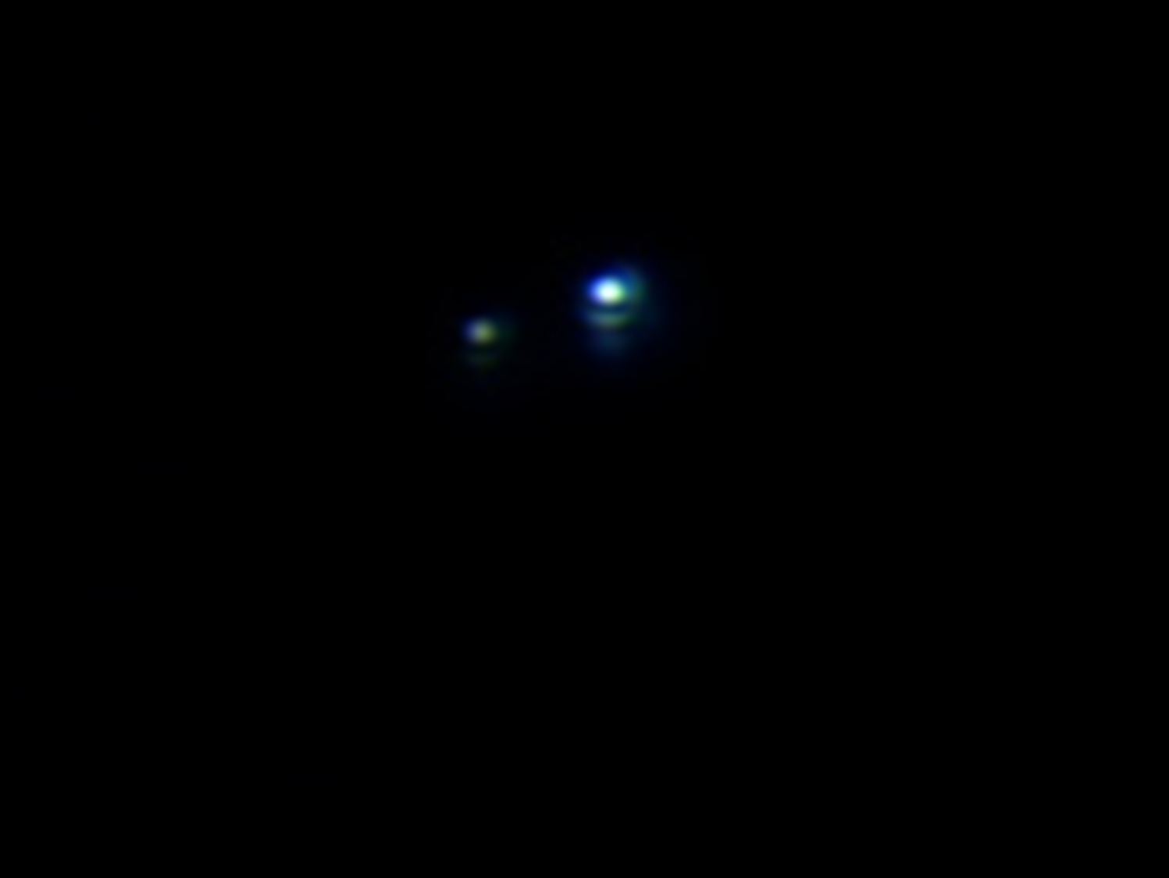
Castor B: double star
Castor Ba & Castor Bb are separated by 0.03 AU, about ¼ the distance from Mercury to the Sun.
They have an orbital period of 3 days.

Slide 17
Castor Ba
Castor Bb
B-V Color Index:
Type:
Luminosity:
Temperature:
Diameter:
Mass:
Magnitude:
+0.03
white
56 Suns
16,500⁰ F
2.84 Suns
1.7 Suns
+1.58
red dwarf
0.5 Suns

Slide 18
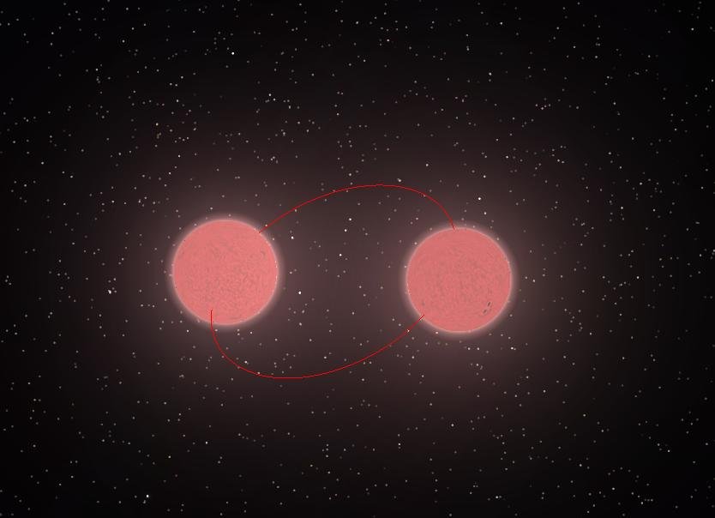
Castor C: double star
This is one of the few known pairs of eclipsing binary stars that are both red dwarfs.
They are both flare stars, which mean that they sometimes give off large amounts of magnetic energy.
They have a combined luminosity of 0.05 Suns.

Slide 19

Castor C: double star
This pair of red dwarfs lie about 1,100 AU from the brighter pair in Castor.
Castor C orbits A & B about every 10,000 years.
They are separated by only 0.018 AU (about 15% of the distance between Mercury & the Sun) and orbit each other every 19.5 hours.

Slide 20
Castor Ca
Castor Cb
B-V Color Index:
Type:
Luminosity:
Temperature:
Diameter:
Mass:
Magnitude:
red dwarf
5,400⁰ F
0.62 Suns
+9.1
red dwarf
5,400⁰ F
0.6 Suns
+9.6

Slide 21
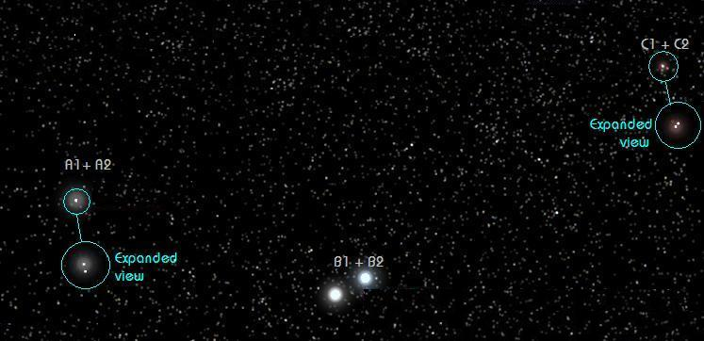
The Castor Star System

Slide 22
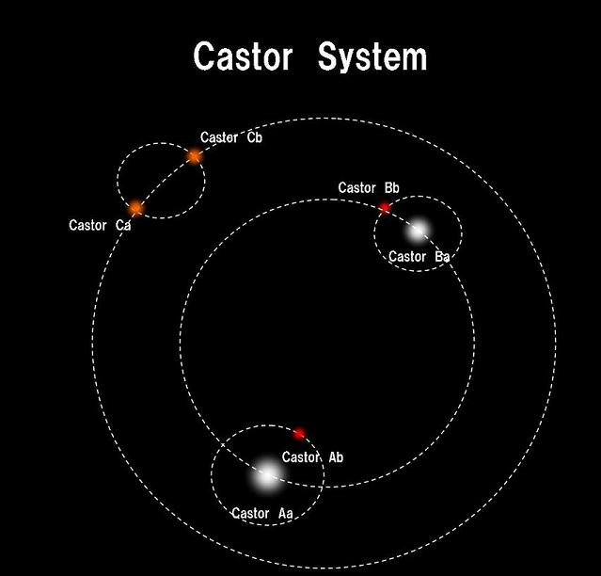

Slide 23
